Slide 1
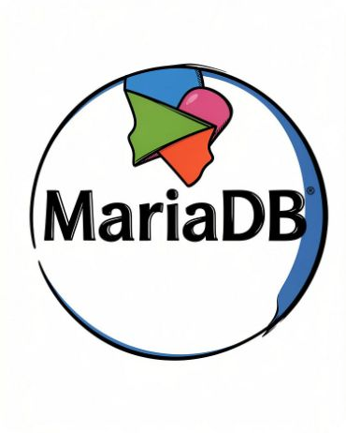
MariaDB Database Management System
Case Study: history, architecture, features, SQL practical and future trends
G. Heamanth kumar reddy
CB.SC.U4CSE25713
SAI VISWAS
CB.SC.U4CSE25762
P.G ROHIT
CB.SC.U4CSE25738

Slide 2

History: MySQL, Sun and Oracle
1990s: MySQL exists
Relational database system developed in the 1990s
Popular for websites and applications; it had an open-source version
Michael “Monty” Widenius was one of its original creators
Widely available and relatively easy to use
2008: Sun acquires MySQL
Sun Microsystems acquired MySQL AB, the company behind MySQL
MySQL came under Sun's ownership
2010: Oracle acquires Sun
Oracle completed its acquisition of Sun Microsystems
MySQL came under Oracle's ownership too
Some community members worried about the project's independence and openness under a large commercial company
Key point: the community wanted a strong, independently developed open-source alternative.

Slide 3
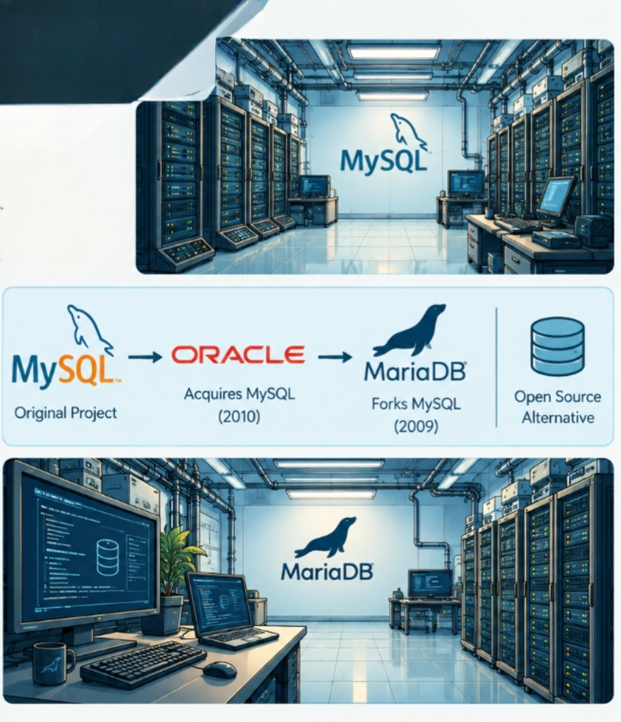
MariaDB Is Born in 2009
Born in 2009: created by Monty Widenius and other original MySQL developers as a fork of MySQL
What does fork mean? a software project is like a tree: developers copy the existing source code and develop that copy independently
  The new project keeps much of the original functionality while adding its own features
Date detail: started in 2009, before Oracle completed its acquisition of Sun in 2010
  Concern about MySQL's independence was background, but MariaDB was not first created in 2010
Why was MariaDB created? (presentation answer)
MariaDB was created to maintain an independently developed, open-source alternative to MySQL. It was founded in 2009 by original MySQL developers led by Michael “Monty” Widenius. Its name comes from Monty's daughter Maria. It retains substantial MySQL compatibility while developing its own features and architecture.

Slide 4
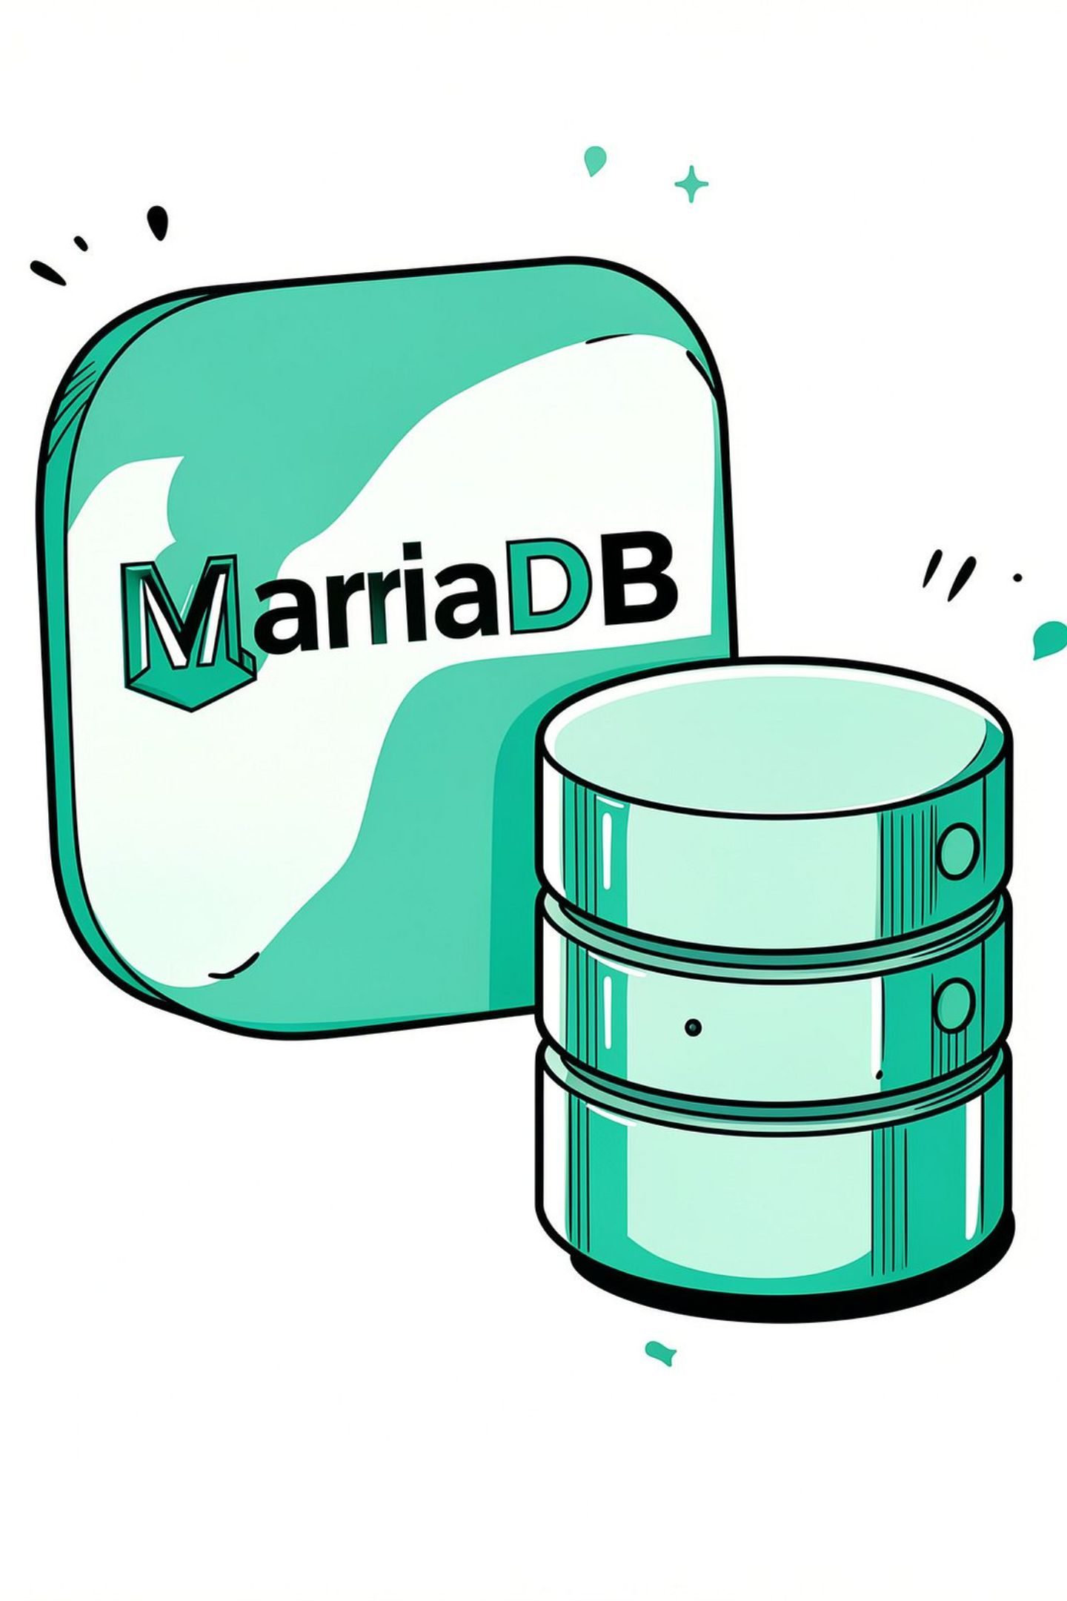
Name and Evolution
Why “MariaDB”?
Named after Maria, Monty Widenius's younger daughter
MySQL was named after his other daughter, My
How it evolved
2009: Founded as a fork of MySQL
2010 onward: Developed into an independently maintained database project
2012: MariaDB Foundation established to support continuity and open-source development
Later years: Added and improved storage engines, security features, replication, performance options and enterprise capabilities
Foundation vs company
The MariaDB Foundation supports the open-source project
It is not the same as the commercial company MariaDB plc

Slide 5
Database Type: The Relational Model
MariaDB is a relational, table-based database system
Example: a college stores students and the courses they study
Instead of one huge table, create related tables
The tables hold different kinds of information; other tables can connect students to their courses
In simple words: the relational model keeps data organized, connected, and consistent
Student table
StudentID | Name | Department
101 | Rahul | CSE
102 | Priya | IT
Course table
CourseID | CourseName
1 | Java
2 | DBMS

Slide 6
Primary Key, Foreign Key and Constraints
Primary key (PK)
Uniquely identifies each record in a table
StudentID can be a primary key: each student has a different ID (Rahul → 101, Priya → 102)
No two records can have the same primary-key value
A primary key cannot be NULL
Foreign key (FK)
Connects related tables and helps prevent invalid relationships
In Enrollments, StudentID refers to Student and CourseID refers to Course
Ensures the referenced student and course actually exist
StudentID | CourseID
101 | 1
102 | 2
Constraints are rules applied to data:
PRIMARY KEY
Uniquely identifies a row
FOREIGN KEY
Maintains relationships between tables
NOT NULL
Does not allow a missing value in that column
UNIQUE
Prevents duplicate values in the column or combination of columns

Slide 7
MariaDB Architecture: How It Works Internally
Client–server architecture.
  Client: the program that requests information (terminal, Java application, database tool)
  Server: MariaDB itself, which receives requests and manages the database
  Storage engine: the component that handles how table data is stored and accessed
1. Client
Sends an SQL query
2. Connection and authentication
Checks connection and user permissions
3. SQL processing and optimization
Understands the query and plans execution
4. Storage engine
Reads, writes and manages table data
5. Result returned
Client displays the requested information
Remember: the client sends the request, the server processes it, the storage engine manages the data, and the result goes back to the client.

Slide 8
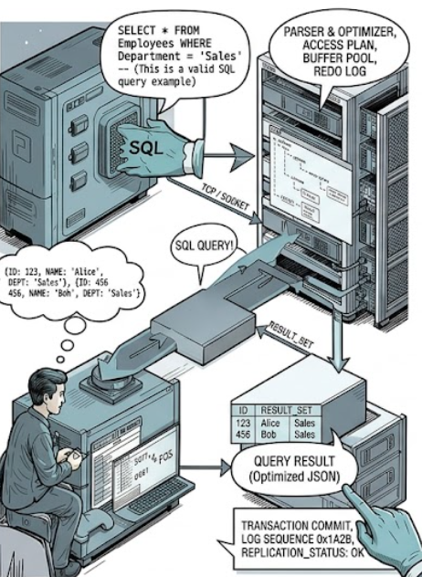
Example: Following a Query
SELECT * FROM Student WHERE StudentID = 101;
Receive: client sends the SQL command via a network connection or local socket
Authenticate: checks the user may connect and has permission
Parse: checks the syntax and understands the request (a misspelled keyword may cause a syntax error)
Optimize: considers efficient ways to get the data; may use an index instead of examining every row
Execute: the storage engine does the reads or writes (with InnoDB, also data access and transaction operations)
Return: sends the matching record to the client
Result
StudentID | Name | Dept
101 | Rahul | CSE

Slide 9
Storage Engines: InnoDB, MyISAM and Aria
A storage engine controls how a table's data is stored, accessed, locked, and recovered after a failure
MariaDB supports different storage engines because not every application has the same requirements
InnoDB (best starting point)
Default engine in modern MariaDB
Supports transactions and ACID properties, and foreign keys
Row-level locking for ordinary row operations; crash recovery
Example: a college fee-payment system where a payment record must be reliable
MyISAM
Non-transactional; useful for certain read-heavy workloads
No transactions or foreign keys
Table-level locking; no InnoDB-style crash recovery
Example: a simple read-only dataset
Aria
Developed for MariaDB; crash-safe table operations for supported use cases
Useful for certain internal operations and temporary tables
Not a general replacement for InnoDB's transactions and foreign keys
Example: temporary or internal query-processing tables

Slide 10
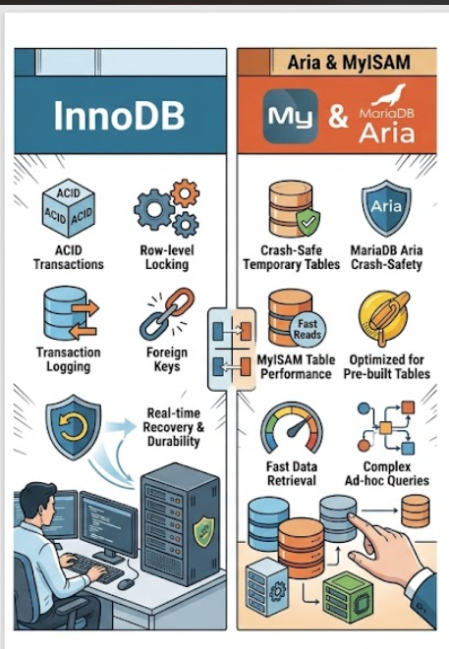
Storage Engines: Quick Comparison
Feature | InnoDB | MyISAM | Aria
Transactions | Yes | No | Not a general transactional replacement
Foreign keys | Yes | No | No InnoDB-style FK support
Locking | Row-level for ordinary row operations | Table-level | Depends on operation; not equivalent to InnoDB
Crash recovery | Transactional recovery | Limited vs InnoDB | Crash-safe design for supported operations
Typical role | Main application data | Certain read-heavy tables | Internal and temporary-table workloads
Which should a beginner choose? For college projects, start with InnoDB. It provides the transactional behavior and foreign keys normally needed for student-management and movie-booking systems.

Slide 11
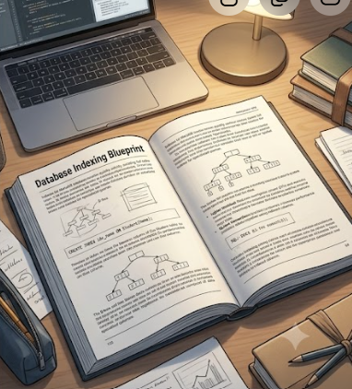
Indexing: Searching Data Faster
Example: a college has one lakh student records and you want to find a student named Rahul
Without an index, MariaDB may examine many rows one after another (a table scan)
An index is an additional data structure that helps locate matching records more efficiently
Like the index at the back of a textbook: check the index instead of reading every page
CREATE INDEX idx_name ON Student(Name);
SELECT * FROM Student
WHERE Name = 'Rahul';
CREATE INDEX creates an index
idx_name the name given to the index
Student the table
Name the column being indexed
The query may use the index to locate matching rows faster.

Slide 12
Index Types, Advantages and Disadvantages
Types
B-tree: equality searches, range searches, some sorting
Full-text: words and text in supported text columns
Spatial: supported geographic or geometric data
Advantages
Faster searches for suitable queries
Faster access for some joins
Can improve sorting and filtering
May reduce the amount of data examined
Disadvantages
Consume disk space
Must be maintained when data is inserted, updated, or deleted
Too many indexes can slow down writes
Important: an index does not guarantee every query becomes faster. MariaDB's optimizer decides whether using an index is beneficial.

Slide 13
Transactions
A transaction is a group of database operations treated as one logical unit
Example: bank transfer of ₹500 from Account A to Account B
  ₹500 must be deducted from Account A
  ₹500 must be added to Account B
If only the first step succeeds, the database is left in an incorrect state
Transactions help prevent this when used with a suitable engine such as InnoDB
START TRANSACTION;
UPDATE Accounts
SET Balance = Balance - 500
WHERE AccountID = 1;
UPDATE Accounts
SET Balance = Balance + 500
WHERE AccountID = 2;
COMMIT;
START TRANSACTION begins it; COMMIT makes changes permanent
ROLLBACK; cancels uncommitted changes
Simplified: real systems also check accounts, funds, permissions and concurrent updates

Slide 14
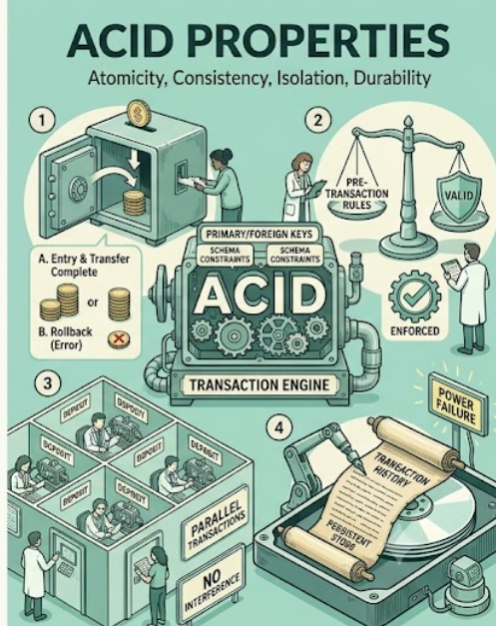
ACID Properties
A: Atomicity
Either all operations in the transaction succeed, or none are committed
Example: debit and credit of a bank transfer succeed together
C: Consistency
A transaction must preserve database rules and constraints
Example: a foreign key should not point to a student who does not exist
I: Isolation
Concurrent transactions are controlled so they do not interfere in ways that violate isolation rules
Example: two people booking seats should not obtain the same seat
D: Durability
Once committed, changes are designed to survive a crash or power failure (subject to configuration and hardware)
Example: a recorded payment should not vanish after a restart

Slide 15
Replication and Replication Modes
Replication means copying database changes from one server to another
Example: a ticket-booking website uses a primary server for changes and replicas to handle some read requests
Replica 1
Can serve suitable read requests
Primary server
Accepts the main database updates
Replica 2
Can support recovery and read scaling
Asynchronous
Primary does not wait for a replica to confirm every transaction
Can offer low latency
Replicas may temporarily lag behind
Semi-synchronous
Primary waits for an acknowledgement from at least one replica
Can reduce the risk of losing acknowledged changes if the primary fails
Adds waiting time; does not guarantee every replica applied it
Galera clustering
Multi-primary cluster with synchronous-style replication and certification
Multiple nodes may accept writes, subject to cluster rules
Needs careful configuration and operation
The presentation also mentions group replication. Exact clustering technology depends on the setup; MySQL Group Replication is a distinct technology, while Galera is a common MariaDB clustering option.

Slide 16
Scalability
Scalability: the ability of a system to handle increased workloads
Vertical scaling: give one server more CPU, RAM, or faster storage
Horizontal scaling: add more servers, such as read replicas, or distribute data using sharding
Sharding: splitting data across multiple servers instead of storing it all on one
Example: a growing movie website
Vertical: upgrade the main database server
Horizontal: add read replicas for movie listings
Sharding: distribute groups of data across servers when the architecture requires it
Replication and scaling improve capacity or availability when designed properly, but add operational complexity and do not automatically guarantee zero downtime.

Slide 17
Core Features: Source, SQL, Transactions, HA
Open source
Source code under open-source licences; community-driven foundation
Developers can inspect, contribute and use it under the licence terms
Benefit: lower licensing costs, less dependence on one vendor
SQL support
SQL to define tables, insert, retrieve, update and manage data
Example: create a database and table, insert a student, display the record (see practical slides)
Transactions
Supported through engines such as InnoDB
Important for payments, ticket booking and student registrations
Replication and high availability
Keeps additional copies of data on other servers
With monitoring and failover, helps an app keep operating when a server fails
High availability = designing to minimize unavailable time
Not a complete backup strategy; keep independent backups

Slide 18
Core Features: JSON, Procedures, Engines
JSON support
Multiple storage engines
Different engines for different storage requirements
Not every table is forced to use the same implementation
JSON is a format for structured information
MariaDB provides JSON functions for working with JSON documents
The JSON type is text-based, unlike the native binary JSON type in some other systems
Useful when records have flexible fields
Stored procedures and triggers
Stored procedure: a named collection of SQL statements stored in the database and run when called
Trigger: runs automatically on an event such as insert, update or delete
Uses: a procedure to calculate a student's total marks; a trigger to record an audit entry when a department changes
Centralize rules and automate repetitive work
{
"movie": "Interstellar",
"language": "English",
"rating": 9
}

Slide 19
MariaDB vs MySQL
Point | MariaDB | MySQL
Origin | Forked from MySQL in 2009 | Original database project
Main stewardship | MariaDB community and Foundation; a commercial company also exists | Oracle and its community
Licensing | Open-source releases under their licences; commercial offerings also exist | Open-source Community Edition and commercial offerings
Storage engines | Multiple engine choices, including MariaDB-specific options | Multiple engines, with InnoDB central to typical deployments
Compatibility | Substantial compatibility with MySQL | Its own evolving implementation and features
Performance | Depends on version, workload, schema and configuration | Depends on version, workload, schema and configuration
Are they the same? No
Common history and many SQL commands, protocols and connectors, but developed separately; SELECT * FROM Student; looks familiar in both
Advanced features, data types, authentication, replication setups and drivers may differ
Drop-in replacement
Software that can replace another with little change to the surrounding application
MariaDB can replace MySQL in many applications, not guaranteed in every case; test before migrating production

Slide 20
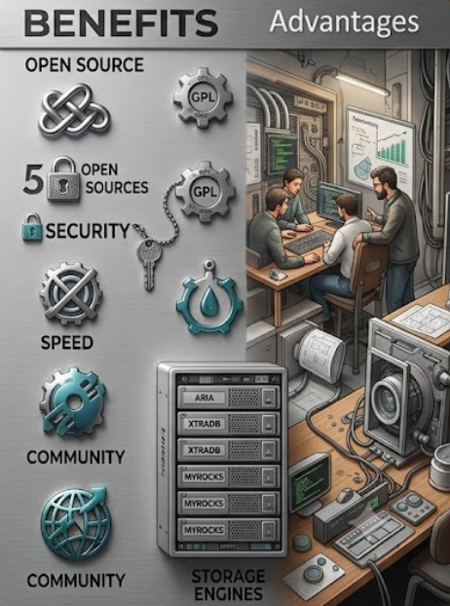
Key Strengths and Why Choose MariaDB
Cost effectiveness
Open-source licensing can reduce software costs
Performance options
Indexes, query optimization and engine choices help tune performance
Security
Authentication, privileges, encryption and auditing options help protect data when configured correctly
MySQL compatibility
Existing MySQL knowledge and many applications can transfer with limited changes
Community development
Documentation, issue reporting and contributions
Flexibility
Different storage engines and replication designs suit different workloads
Why choose MariaDB? open-source database options; strong SQL support; flexible storage engines; transaction and replication capabilities; familiarity for developers who already know MySQL
Note: MariaDB is not automatically faster than every other database; performance depends on queries, data size, indexes, server resources, version and configuration

Slide 21
Limitations and Considerations
Enterprise adoption and ecosystem: used in production, but ecosystem and adoption differ from Oracle Database and other enterprise platforms; commercial tools and support may differ
Clustering complexity: advanced clustering, including Galera, needs careful setup and monitoring (node failures, network delays, quorum, conflicts, recovery)
Commercial tooling: a particular enterprise management tool, integration or support service may not be available in the form required; check before choosing
Other practical challenges
Poorly designed queries can be slow
Missing or excessive indexes can harm performance
Backups and recovery need planning
Security depends on correct configuration
Migration from MySQL can require application or SQL changes
Main lesson: MariaDB is a capable database, but good database design and administration are still necessary.

Slide 22
Applications and Real-World Use Cases
Banking systems
Customer information, transaction records and account details; transactions need careful integrity and security controls
E-commerce
Products, customers, orders, payments and inventory; indexes and suitable architectures support growing traffic
Educational institutions
Student records, course details, grades, attendance and enrollment data
Healthcare
Patient appointments and other structured records; access controls, privacy and regulatory compliance are essential
Government services
Citizen records, applications and administrative systems where security and reliable recordkeeping matter
Cloud platforms
Run in virtual machines or containers, or use a managed MariaDB service where available

Slide 23
Example Project: Movie Booking System
Table | What it stores
movies | Movie names, genres, durations
theaters | Theater names and locations
shows | Which movie plays at which theater and when
tickets | Customer names, seats, booking status
MariaDB manages these records
Primary and foreign keys connect the tables
Indexes help suitable searches
Transactions help protect related booking operations
Application logic and constraints must prevent two customers from booking the same seat for the same show

Slide 24
Hands-on SQL: Create, Insert and Read
CREATE DATABASE CollegeDB;
USE CollegeDB;
CREATE TABLE Student (
StudentID INT PRIMARY KEY,
Name VARCHAR(50),
Department VARCHAR(20)
);
INSERT INTO Student
VALUES (101, 'Rahul', 'CSE');
INSERT INTO Student
VALUES (102, 'Priya', 'IT');
SELECT * FROM Student;
CREATE DATABASE / USE: create a database and select it
CREATE TABLE: StudentID INT PRIMARY KEY (unique, non-null); Name VARCHAR(50); Department VARCHAR(20)
INSERT: adds Rahul, then Priya
SELECT *: reads all columns
Expected output
StudentID | Name | Department
101 | Rahul | CSE
102 | Priya | IT
Run these in a MariaDB command-line client or an SQL editor connected to your MariaDB server.

Slide 25
Update, Delete, CRUD and Best Practice
UPDATE Student
SET Department = 'AIDS'
WHERE StudentID = 101;
DELETE FROM Student
WHERE StudentID = 101;
Changes Rahul's department to AIDS
Why WHERE? Without it, every row's department would change
Removes the row whose student ID is 101
The record is deleted, not merely hidden
Letter | Operation | SQL example
C | Create | INSERT adds a record
R | Read | SELECT retrieves records
U | Update | UPDATE modifies records
D | Delete | DELETE removes records
Best practice
Before an update or delete, run a SELECT with the same WHERE condition to verify the rows
For multi-step changes, use transactions when the engine supports them
“Create” in CRUD means creating a data record; CREATE TABLE creates the table structure

Slide 26
Joins: Connecting Data from Multiple Tables
A JOIN combines related information from two or more tables
Student stores a department ID, while Department stores the department name
To display each student's name with the department name, use a JOIN
Student
Department
StudentID | Name | DeptID
101 | Rahul | 1
102 | Priya | 2
103 | Arjun | 1
DeptID | DeptName
1 | CSE
2 | IT

Slide 27
Join Example, INNER JOIN and Common Mistakes
CREATE TABLE Department (
DeptID INT PRIMARY KEY,
DeptName VARCHAR(20)
);
INSERT INTO Department VALUES (1, 'CSE');
INSERT INTO Department VALUES (2, 'IT');
SELECT Student.Name, Department.DeptName
FROM Student
JOIN Department
ON Student.DeptID = Department.DeptID;
Expected result
Name | DeptName
Rahul | CSE
Priya | IT
Arjun | CSE
INNER JOIN: JOIN alone means INNER JOIN; returns rows with matching values in both tables, so a student with no matching department will not appear
Common mistake: a wrong join condition may give missing records or a Cartesian product (many rows combined with many others)
Correction to the original slide: it compared Student.Department (text) with Department.DeptID (integer), which do not match. The corrected example adds DeptID to Student and joins it to Department's primary key.

Slide 28
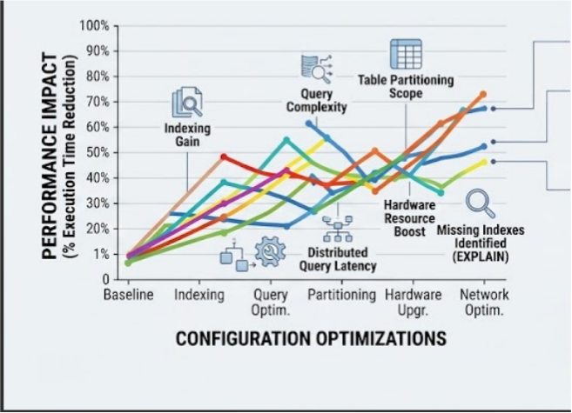
Performance Considerations and EXPLAIN
Performance means how efficiently MariaDB executes queries and handles its workload. Five major factors:
1. Indexing: helps find rows without scanning the whole table; choose indexes based on actual queries
2. Query complexity: avoid unnecessary columns, use suitable filters and joins, inspect slow queries
3. Table size and partitioning: large tables need extra design; partitioning helps particular workloads but not every query
4. Hardware resources: CPU, memory, storage speed, disk space
5. Network latency: slow communication between application and database, or between replicated servers, increases response time
EXPLAIN
SELECT * FROM Student
WHERE StudentID = 101;
EXPLAIN: shows how MariaDB plans to execute a query, including the table access method and indexes the optimizer expects to use
Beginner rule: before optimizing a slow query, examine its execution plan. Do not add indexes randomly.

Slide 29
Future Trends
Cloud databases
Managed services where the provider handles some maintenance, backups, patches and scaling
MariaDB can be deployed in cloud environments; services depend on the provider
AI integration
AI applications need databases to store information, retrieve records and support analytics
Used through application code, SQL queries and integrations; vector-search features depend on version and product
Improved security
Strong authentication; least-privilege access
Encryption in transit and, where configured, at rest
Security updates and auditing; secure backups
Protects against unauthorized access and accidental loss
Better scalability
Read replicas, clustering, distributed architectures and sharding handle larger workloads
Each has different consistency, complexity and cost trade-offs
Advanced analytics
Databases increasingly support analytical queries, business intelligence and reporting
MariaDB can take part, depending on engine, configuration and query requirements
Main idea: future database development focuses on making data systems more scalable, secure, cloud-friendly, and useful for analytics and AI.

Slide 30
Conclusion
MariaDB at a glance
Open-source relational database management system created in 2009 as a fork of MySQL
Organizes data into tables and uses SQL to create, retrieve, modify, and manage information
Client–server architecture: applications send queries to a server, which works with storage engines to access data
Main capabilities
Relational tables, keys, constraints, and SQL
Storage engines such as InnoDB, MyISAM, and Aria
Indexing and query optimization
ACID transactions with suitable engines
Replication and clustering options
Stored procedures, triggers, and JSON functions
Uses from student databases to e-commerce and production systems
Major advantages: open-source options, compatibility with many MySQL applications, and flexible architecture
Practical challenges: configuration, performance tuning, migration differences, and advanced cluster management
The right choice depends on an application's requirements, workload, security needs, operational resources, and budget

